Slide 1
Understanding Probability Foundations
Independent vs. Dependent Events
Independent Events:
Definition: The outcome of one does not affect the other
Examples: Rolling a die or tossing a coin
Probability remains same (1/6 each roll)
Dependent Events:
Definition: First outcome changes second probability
Example: Drawing marbles without replacement
3 red, 2 green → probabilities change
Mathematical Rule:
P(A and B) = P(A) × P(B|A) (The probability of B given that A has occurred).

Slide 2
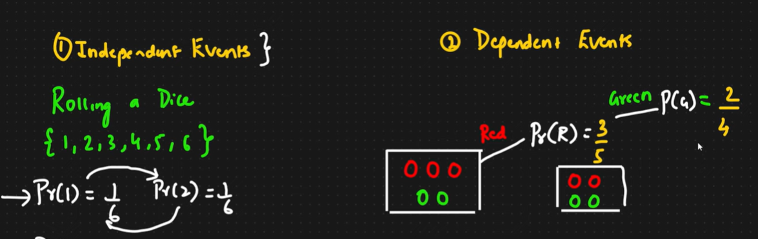
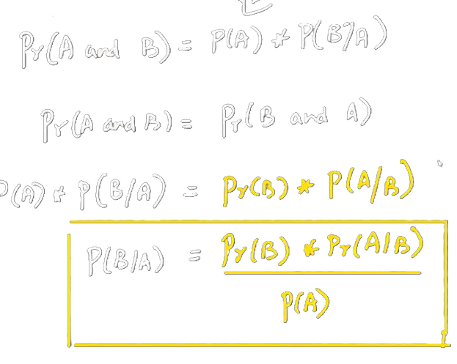
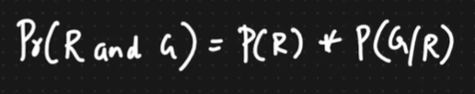
CONDITIONAL PROBALITY
NAÏVE BAYES THEOREM

Slide 3
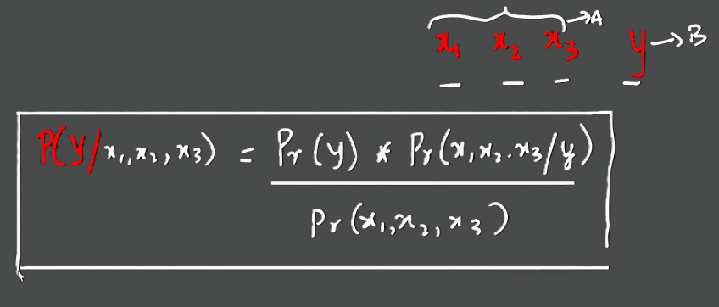

Slide 4


Slide 5
Assignment Task — Logistic Regression
Project: Heart Disease Prediction
Objective: Classify patients as High Risk (1) or Low Risk (0)
Dataset: 200 patients
Features:
X1: Daily Steps
X2: Sleep Hours
Target: Heart Health Indicator
Tasks:
Check if variables are independent/dependent
Train Logistic Regression model
Threshold = 0.5
If probability = 0.72 → classify as 1

Slide 6
Mathematical Implementation
Sigmoid Logic
Given weights: w0 = -5, w1 = 0.001, w2 = 0.5
Patient: Steps = 6000, Sleep = 7
Step 1: z = w0 + (w1 × Steps) + (w2 × Sleep)
Step 2: σ(z) = 1 / (1 + e^-z)
Step 3: Compare with threshold 0.5
Determine final classification

Slide 7
Model Evaluation
Generate Confusion Matrix
Questions:
False Positive: What does it mean?
False Negative: What does it mean?
Risk Assessment:
Which error is more dangerous?
Why higher Recall is important in medical models

Slide 8
Submission Requirements
Python File: heart_prediction.py
Include code + metrics
Summary Slide:
Explain Independent vs Dependent events
Relate to real datasets

